Slide 1
Support and Command Center (SCC)
Presented by:
Dolot, Patrick Vonn
Rivera, Mark Jerome
Cayaban, Francis Paolo

Slide 2
Main Objective

Slide 3
Problem Statement
Had issues in transmission logs
Unsynchronized timestamp
Does not have logs or reports for transmission issues

Slide 4
Project Overview
The Support and Command Center (SCC) is a Web-based application that aims to provide a Logging System that will support the support center processes namely :
Registration of all BEI and BOC
Document and note technical support calls
Transmission confirmation for election returns to the Board of Canvassers
The said project will serve as an evidence after the election if there will be a protest against the results of the election.

Slide 5
Scope and Limitation
Will create call documentation using text files
Will be limited to 5 users namely
Administrator
Registrar
Team Leader
Agent (Call center agent)

Slide 6
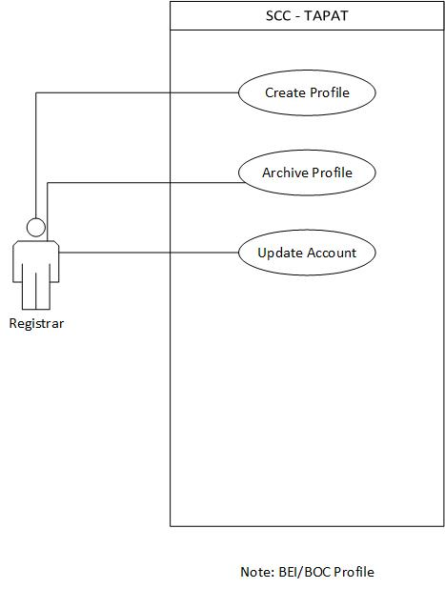
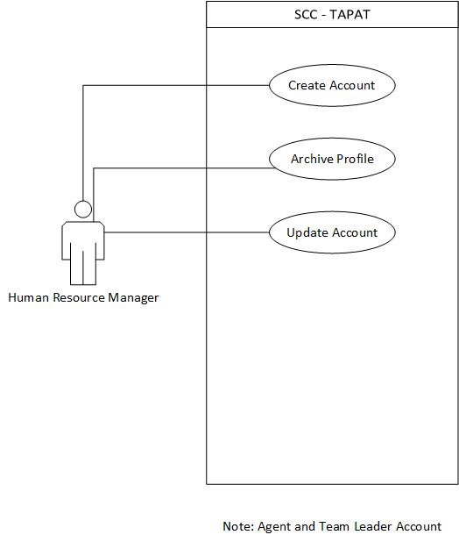
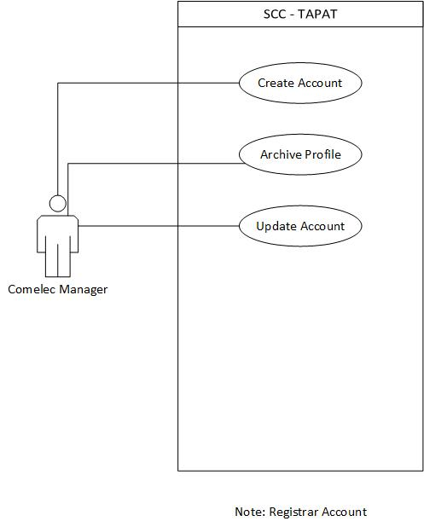
Use Case

Slide 7
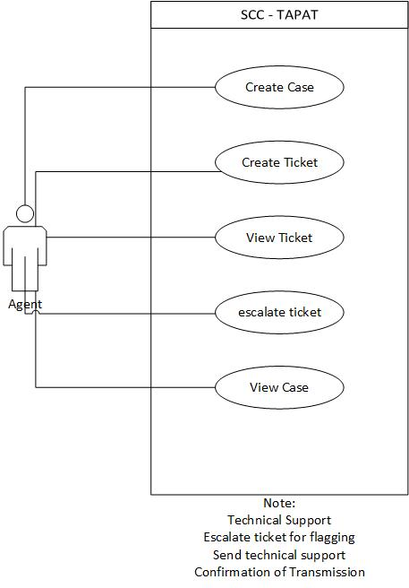
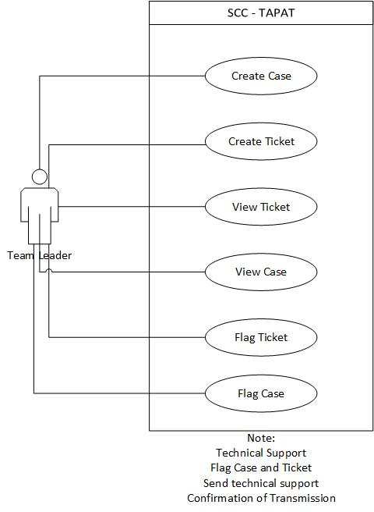
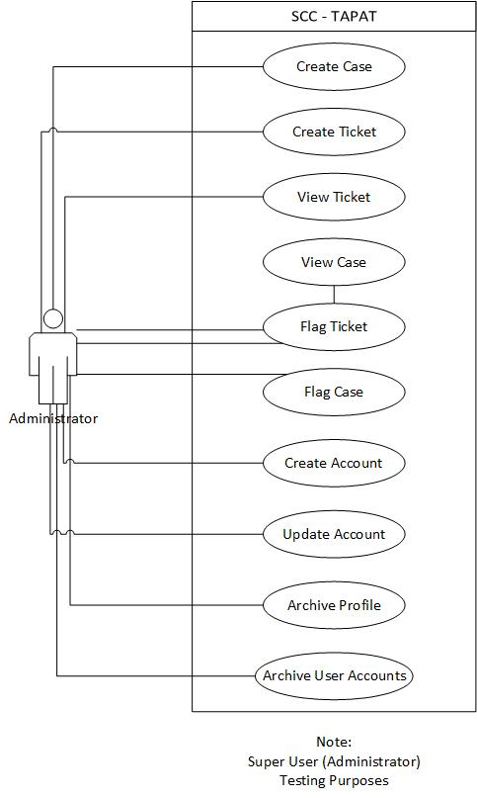
Use Case

Slide 8
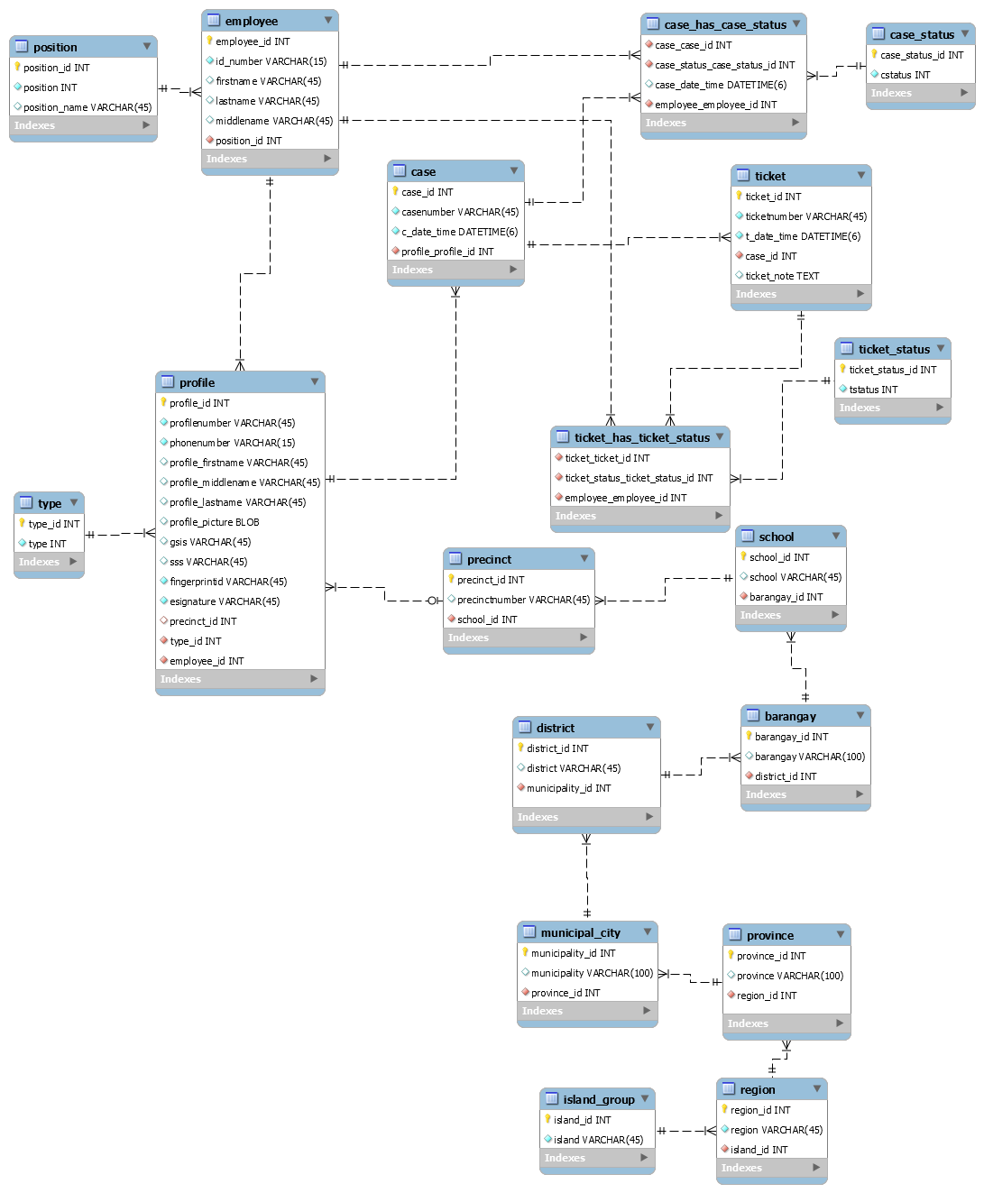
ERD

Slide 9
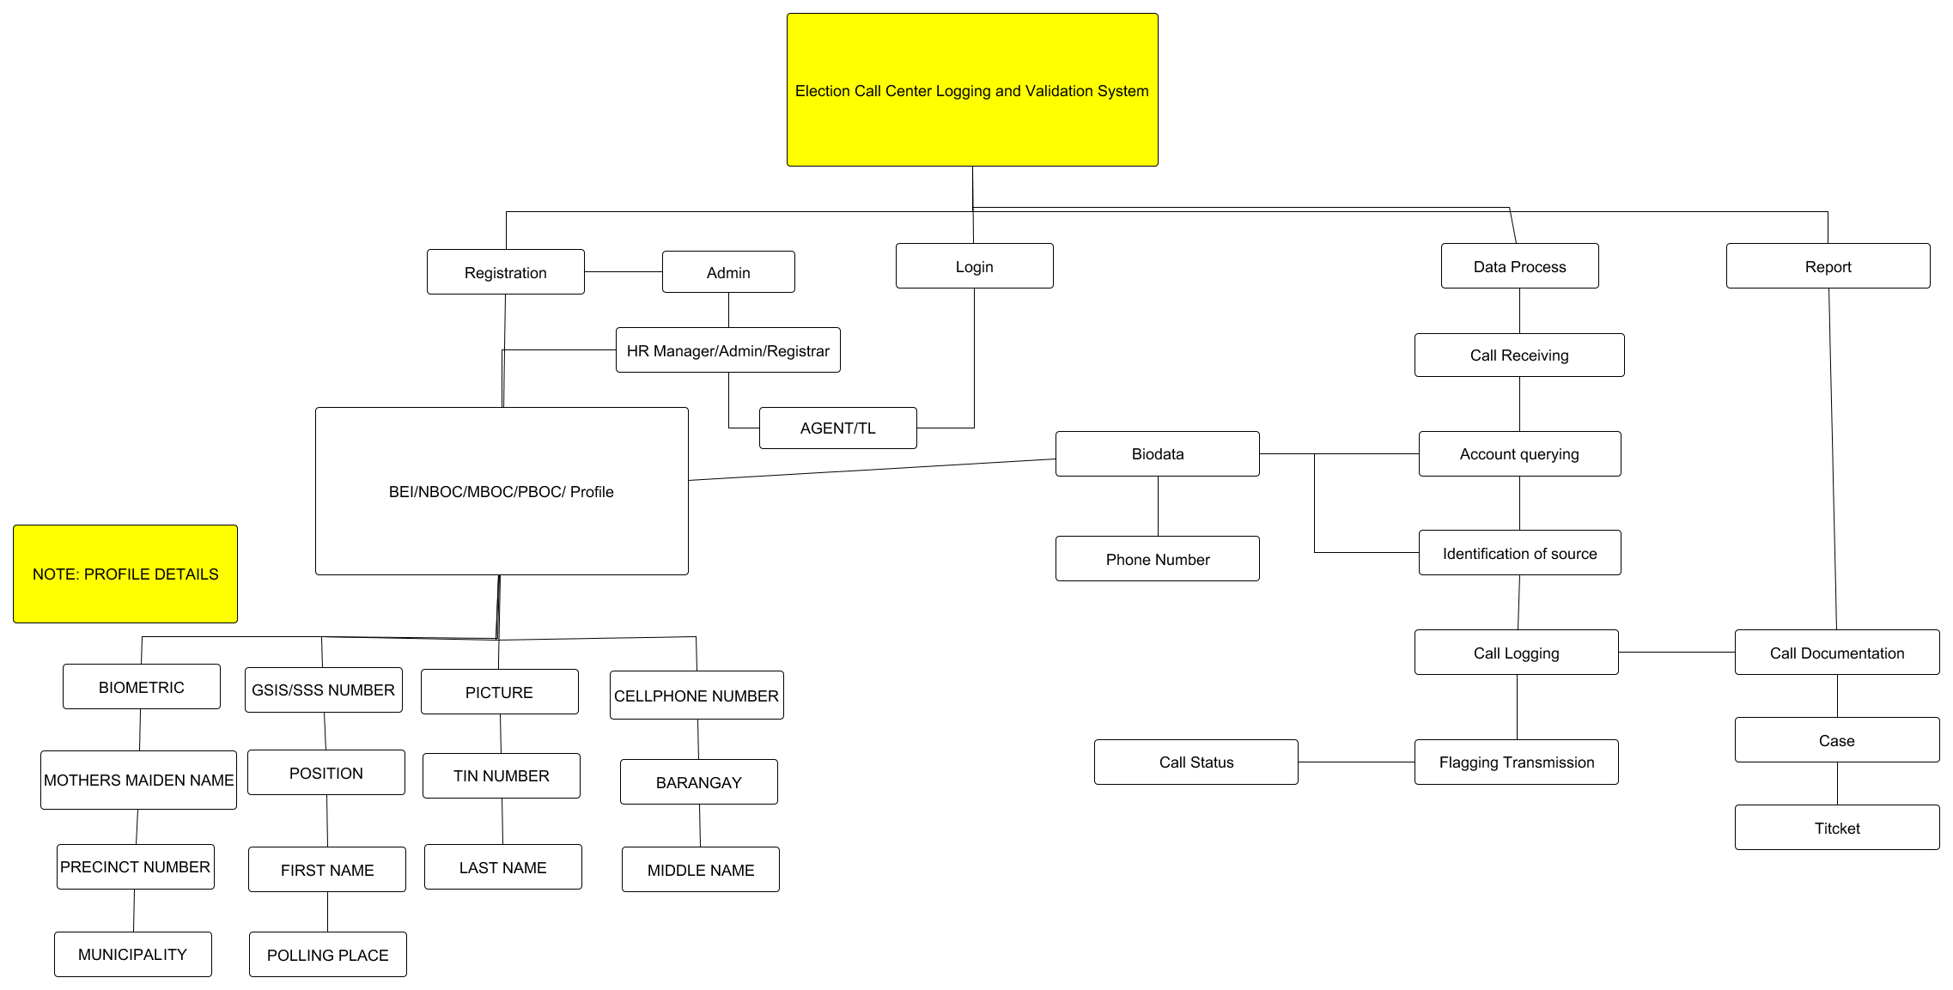
Site map

Slide 10
Reference
Republic Act 9369
Comelec Resolution no. 8879
Comelec Resolution no. 8900

